Slide 1

FIELDPROOF
BUY FRESH READINGS
FROM SENSORS
Notes:
Software can spend money online. But when it needs to know what is happening somewhere physical, it still needs access to someone else’s sensor—or a person to go check. FieldProof lets software buy that check from a device operator.

Slide 2
FIELDPROOF
THE PROBLEM AND THE TRANSACTION
WHEN SOFTWARE NEEDS
A PHYSICAL ANSWER
If reliable live data isn’t available, someone still has to check.
01
02
03
04
REQUEST
PAY
MEASURE
VERIFY
The operator receives payment. The buyer receives a signed reading for its request.
02
Notes:
The buyer requests a reading and sets an age limit. The device operator receives the payment, and the device measures and signs its answer for that specific request. The buyer checks the origin, signature, and freshness. This is a paid, requested check—not just another live dashboard.

Slide 3
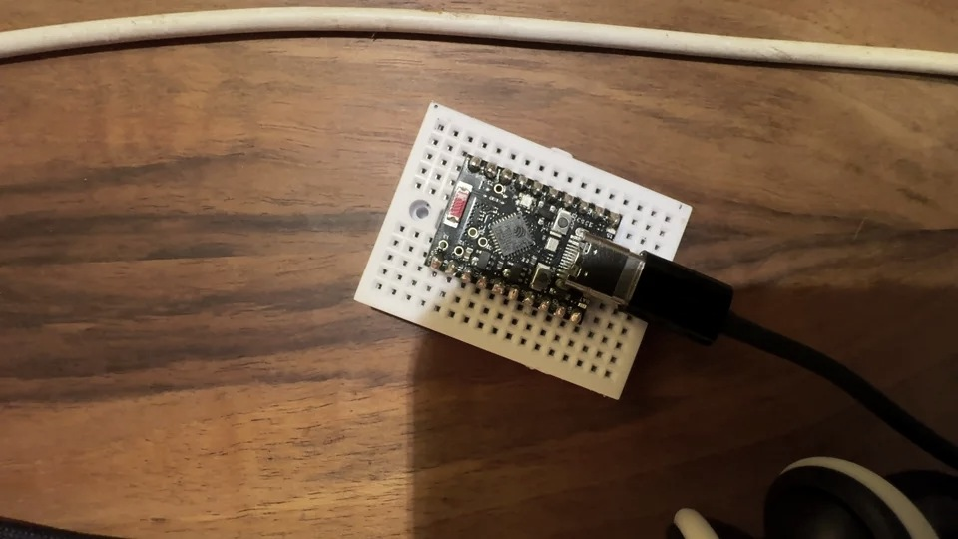
FIELDPROOF
WORKING PROTOTYPE
ONE REAL, PAID PHYSICAL CHECK
An integrated transaction on PEAQ’s AGUNG testnet.
PEAQ AGUNG
Checks the registered device identity and signing key before purchase
SOLANA DEVNET
x402 payment; pays the operator 0.001 test USDC
ESP32
Takes and signs a fresh contact reading
PEAQ + SEEKER
ESP32-C6 · Using BOOT button as contact input
Peaq work record; phone verifies receipt
03
Notes:
I am a computer science graduate building this independently. I wanted to test the entire transaction rather than pitch an imaginary marketplace. The actual prototype uses an ESP32. Solana handles a Devnet test payment. Before buying, the software checks that device’s registered key on peaq Agung. The ESP32 then signs a new reading. A peaq Storage record links the completed job, and a Seeker phone independently checks the receipt. These are verified testnet and hardware operations, not customer payments or an EventRegistry credit rating.

Slide 4
FIELDPROOF
WHY VERIFICATION MATTERS
PAYMENT STAYS FINAL.
THE READING EXPIRES.
Settled payment and usable physical evidence are different things.
PAYMENT
PHYSICAL READING
Still settled
Too old after 10 seconds
Edit the signed answer → verification fails.
04
Notes:
The most interesting technical insight is that the payment remains settled but the observation only stays useful briefly. After ten seconds the buyer refuses to rely on the same reading for a new decision. If the answer is edited, its signature no longer verifies. Of course a signature cannot prove a dishonest sensor told the truth; it establishes attributable, untampered evidence from the enrolled key.

Slide 5
FIELDPROOF
OPPORTUNITY AND NEXT STEP
ONE USEFUL CHECK.
THEN A NETWORK.
First buyer to test:
Software teams managing remote equipment they don’t own.
NEXT
Find one repeated, costly check. Run one pilot.
Compare with the existing method.
Long-term: independent devices earning from useful physical services.
05
Notes:
The first customers I want to approach are software teams managing equipment at sites they do not operate. When existing telemetry cannot supply a reliable answer, a paid remote check might replace a manual check. That needs to be validated with a real operator and an actual recurring question. I would measure reliability, useful answers and integration effort against the current workflow. The bigger opportunity is allowing existing independently operated devices to earn money by performing useful checks for other software. I am building toward that, but not claiming there is already an operating marketplace.

